Slide 1


Artificial Intelligence as a driver for Innovation in Official Statistics Francesco Pugliese, Central Directorate for Methodology and Design of Statistical Processes, Istat ARTIFICIAL INTELLIGENCE AND OFFICIAL STATISTICS: THE NEW FRONTIER OF INNOVATION Caserta | 12 November 2025 | University of Campania “Luigi Vanvitelli” | Department of Mathematics and Physics | Abramo Lincoln Street, 5 QUINDICESIMA GIORNATA ITALIANA DELLA STATISTICA
Istat | DCME | MEC

Slide 2

WP13’s Istat PoC – Introduction
With the digitalization of information and the increasing accessibility of administrative data, the amount of data to be handled has grown substantially in recent years. This raises significant concerns about data protection and privacy since the disclosure of sensitive information can pose serious risks to individuals, institutions, and public administrations.
Maintaining digital security and protecting the privacy of personal data have become key challenges in today’s data-driven 21st-century society. An effective way to tackle these issues could be the use of synthetic data.
Notes:
One of the objectives of the project is precisely to investigate whether and to what extent synthetic data can protect personal data while maintaining statistical usefulness

Slide 3

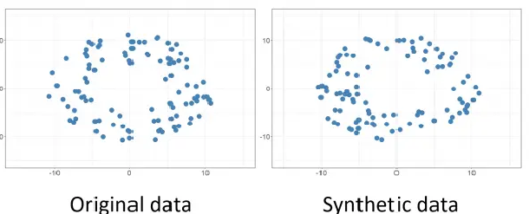
WP13’s Istat PoC – Introduction
Synthetic data are artificially created datasets intended to replicate the statistical characteristics and structure of real data, while preventing the exposure of sensitive or personally identifiable information.
Keep in mind! Synthetic data do not necessarily reproduce the atomic data (categorical, numerical, etc) from the original source. Synthesis capability might rely rather on the relationships between different kind of entities, such as people and objects, school and neighborhoods, or users and cellular antennas.
By generating new records that replicate the characteristics of the original data, synthetic datasets aim to enable researchers and organizations to perform analyses without revealing real individuals’ information, thereby minimizing privacy risks.
Notes:
One of the objectives of the project is precisely to investigate whether and to what extent synthetic data can protect personal data while maintaining statistical usefulness

Slide 4

WP13’s Istat PoC – Purpose
The purpose of this work is to investigate and assess techniques for generating synthetic data from real datasets, with the goal of achieving a balance between two key objectives: (i) preserving the statistical integrity of the original data and (ii) ensuring robust confidentiality protections.
At the policy level, European regulations—most notably the General Data Protection Regulation (GDPR)—establish a comprehensive legal framework for data protection, emphasizing privacy-by-design principles and accountability on the part of data controllers.
In parallel, reports from European institutions, including the European Union Agency for Cybersecurity (ENISA), underscore the growing frequency and severity of data breaches across Europe, emphasizing the urgent need for advanced privacy-preserving approaches in data management.

Slide 5

WP13’s Istat PoC – Dataset
In this study, the analyzed data relate to the frequency and attributes of trips and vacations undertaken by residents of Italy. They originate from the Istat Trips and Holidays survey, as a module of the Household Budget Survey (HBS) which collects information on the tourism flows of residents. This information includes journeys made for leisure or work, both domestically and internationally.
The correspondent public-use files (PUF) were chosen as a simple example of official statistics data. Its public accessibility guarantees the reproducibility of the experiment.
Dataset dimension: 22,404 records collected from 2019 to 2023 and 45 variables.

Slide 6

WP13’s Istat PoC – Data Selection
The variables included in this study were chosen to optimize analysis, reduce missing data, and limit the number of categories for categorical variables
The reference year selected is 2023 to exclude the COVID period. Comparative analyses for other years are provided in the appendix. Consequently, the dataset comprises 14 variables and 4,932 data points (individuals).
Numerical Variables: mese, annrif, GGINIZ, DURATA, npart, ESPE_CO, ESPE_GIO
Categorical Variables: sesso, eta10, staciv4, pnasc, istr4, DEST_IE, ORGALL, ORGTRA

Slide 7
WP13’s Istat PoC – Dataset Description
Numerical Variables
ANNRIF | The reference year when the vacation ended.
MESE | The month of return from the vacation.
GGINIZ | The starting day of the month when the vacation began.
DURATA | The duration of the stay, measured in days.
NPART | The number of participants in the trip. (e.g., 4 for a couple traveling with their two children).
ESPE_CO | Consumption expenditures, expressed in euros (€).
ESPE_GIO | Expenditures for leisure/recreational activities, expressed in euros (€).
Notes:
The dataset we used in this experimental study consists of several variables that can be divided in subgroups:
We have a group of variables referring to the time period of the holiday and other information;
A group of variables identifying the person who made the vacation

Slide 8
WP13’s Istat PoC – Dataset Description
Categorical Variables
GENDER (sesso) | Indicates the individual’s sex: 1 → Male 2 → Female
AGE GROUP(eta10) | Represents the individual’s age class: 0–14, 15–24, 25–34, 35–44, 45–54, 55–64, 65–74, 75+
MARITAL STATUS (staciv4) | Includes four categories: 1 → Single 2 → Married 3 → Separated/Divorced 4 → Widowed

Slide 9
WP13’s Istat PoC – Dataset Description
Categorical Variables
COUNTRY OF BIRTH (pnasc) | Identifies whether the person was born in Italy: 1 → Italy 2 → Other country
TRIP DESTINATION (DEST_IE) | Specifies trip type: 1 → Within Italy 2 → International
Accommodation Organization (ORGALL) Transport Organization (ORGTRA) | Describes how accommodation was arranged: 1 → Direct booking 2 → Through agency / tour operator 3 → No booking 4 → Don’t know / No answer Describes how transportation was arranged: 1 → Direct booking 2 → Through agency / tour operator 3 → No booking 4 → Don’t know / No answer

Slide 10
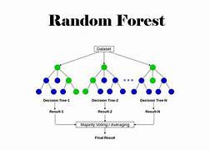
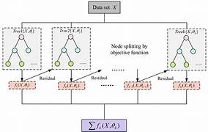
WP13’s Istat PoC – Random Forest and XGBoost
All categorical columns are first converted to numeric values using target encoding to allow Random Forest models to process them. For each column in the dataset, the algorithm treats it as the target to be predicted: a) If the column is categorical then use RandomForestClassifier b) If the column is numeric then use RandomForestRegressor. The chosen Random Forest model is trained to learn how this column depends on the remaining features. After training, the model predicts values for all rows. These predictions become the synthetic version of that column. By iterating through all columns, we build a full synthetic dataset that preserves relationships learned by Random Forest.
We made exactly the same with XGBoost.
XGBoost

Slide 11
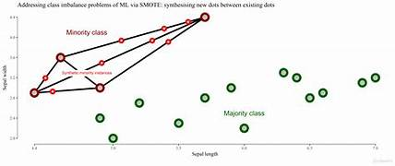
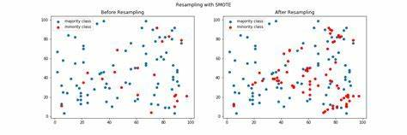
WP13’s Istat PoC – SMOTE and SMOTENC
SMOTE (Synthetic Minority Over-sampling Technique) creates artificial samples for minority classes by interpolating between nearby data points. This method prevents simple duplication of existing records, but it assumes the target is categorical and all features are numeric.
SMOTENC is an adaptation of SMOTE designed for datasets that contain both numerical and categorical features. In this approach, numerical variables are interpolated just like in SMOTE, while categorical variables are assigned the most frequent value (mode) among neighboring samples. This enables the generation of fully synthetic data while maintaining the meaning of categorical attributes.

Slide 12
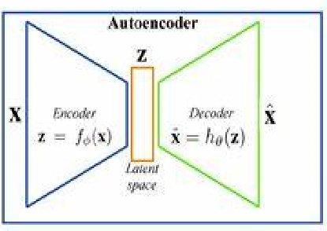
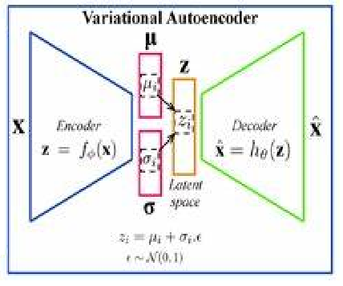

WP13’s Istat PoC – Variational Autoencoder (VAE)
Variational Autoencoders (VAEs) are generative models that learn a compressed, latent representation of data. Encoder: transforms input data xxx into latent variables zzz. Decoder: reconstructs the original data xxx from zzz. Training involves maximizing the Evidence Lower Bound (ELBO), which balances a reconstruction loss with a KL divergence regularization term. The reparameterization trick enables gradients to propagate through the stochastic latent variables.
After training, synthetic data can be generated by sampling z∼N(0,I)z \sim N(0, I)z∼N(0,I) and passing it through the decoder. In practical applications, the SDGym (SD Vault) TVAESynthesizer provides a tabular VAE implementation with configurable hyperparameters, including latent dimension, encoder/decoder architecture, embeddings for categorical variables, batch size, and number of training epochs.
Notes:
To perform our task we used the framework SDV and Smartnoise, that we choose because they are equipped with implementation of many AI Algorithms, including TVAE and CTGAN, and they are very well documented., so they turned out to be very easy to use

Slide 13
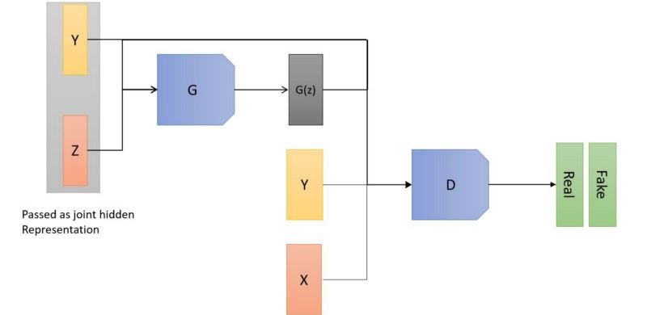

WP13’s Istat PoC – Conditional Tabular GANs – CT GANs
Conditional Tabular GAN (CTGAN) is tailored for tabular datasets containing both continuous and categorical features. It incorporates: Mode-specific normalization for continuous variables. Conditional generation for categorical variables to address class imbalance. Training-by-sampling to ensure minority categories are adequately learned.
In CTGAN, a generator (G) transforms noise and condition vectors into synthetic samples, while a discriminator (D) distinguishes between real and generated data. Both networks’ loss functions are conditioned on category information.
The SDGym (SD Vault) CTGANSynthesizer provides a practical implementation of CTGAN with adjustable generator and discriminator architectures, batch size, number of epochs, and sampling strategies.

Slide 14
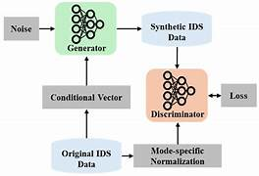


WP13’s Istat PoC – Differential Privacy CT GANs – DP-CTGANs
DP-CTGAN extends CTGAN by integrating differential privacy (DP) during training, guaranteeing formal privacy for the data. - The discriminator is trained with DP-SGD : per-sample gradient clipping and noise addition. - Generator learns only from the DP discriminator. Losses are adapted to include DP noise. Synthetic data generation follows the same procedure as CTGAN.
The SmartNoise’s DPCTGANSynthesizer provides hyperparameters for noise vectors, condition vectors, network architectures, embedding dimensions, privacy parameters (ε, δ, σ), optimization settings, and sampling size.
Since DP-CTGAN introduces noise into the parameters of the CTGAN model, the privacy gain can increase at the expense of performance, which is lower compared to standard CTGAN. Therefore, there is a trade-off between privacy and performance.

Slide 15
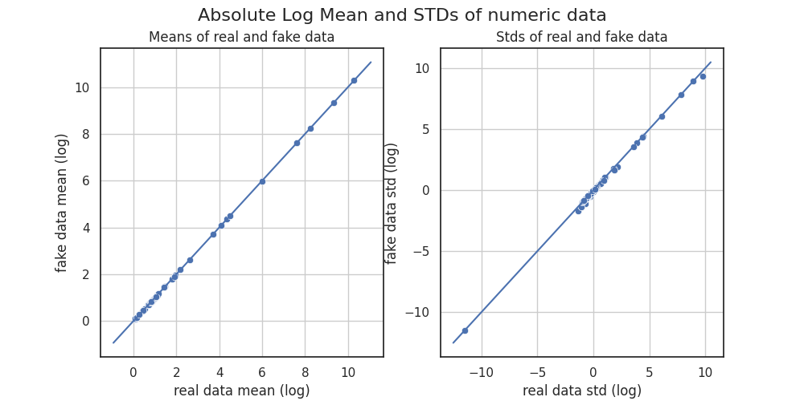
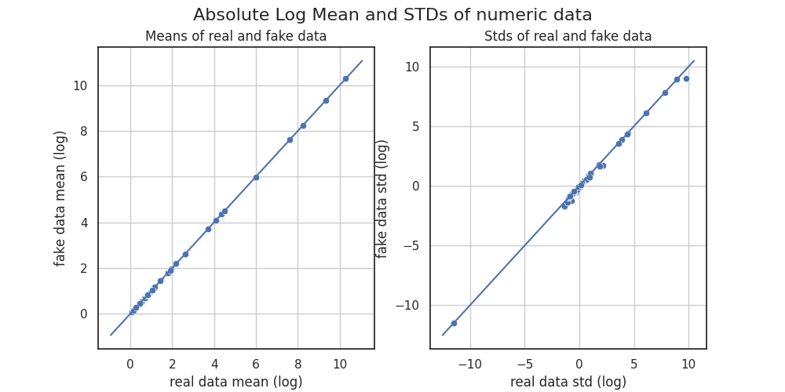
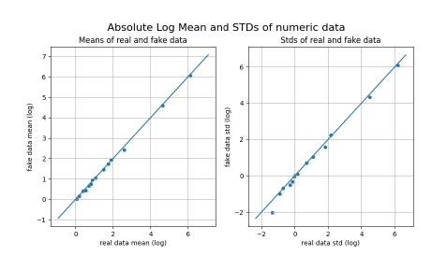
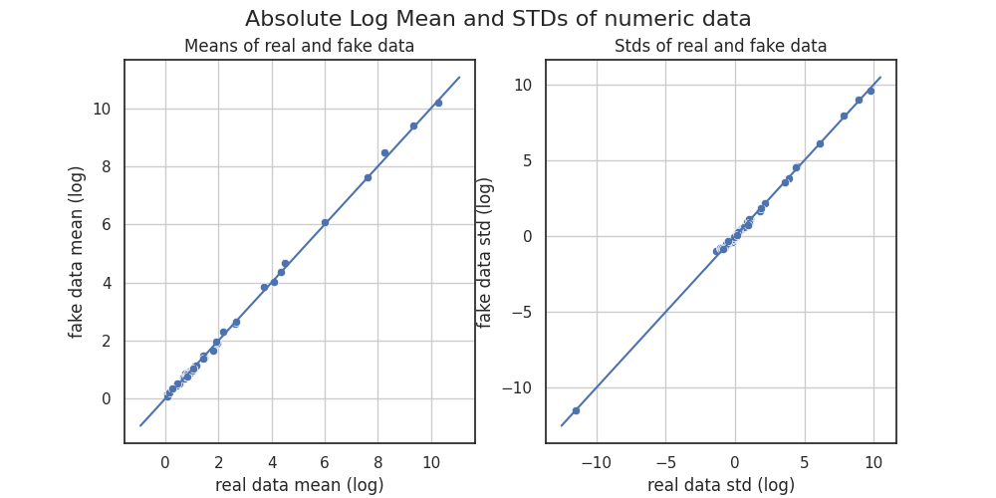
WP13’s Istat PoC – Mean and Std Tests
Random Forest
XGBoost
We evaluated the quality of the synthetic datasets using the Table Evaluator module in python, which offers visual comparisons against the original data.
Here we have a comparison of column-wise means and standard deviations between real and synthetic datasets.
Variational Autoencoder (VAE)
CT-GAN

Slide 16
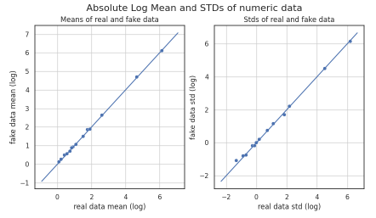
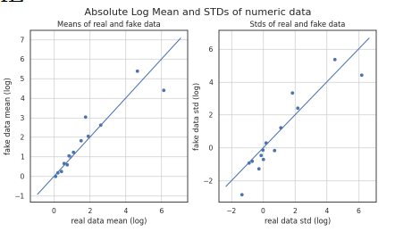
WP13’s Istat PoC – Mean and Std Tests
SMOTENC
DP-CTGAN
As we can see, all methods show collinearity between the standard deviations and means across all features.
The Differential Privacy–CTGAN is the only method exhibiting a lower correlation between feature means and standard deviations. This reduction results from the privacy constraints imposed by differential privacy, which trade off model performance for increased privacy according to the specified privacy budget.

Slide 17
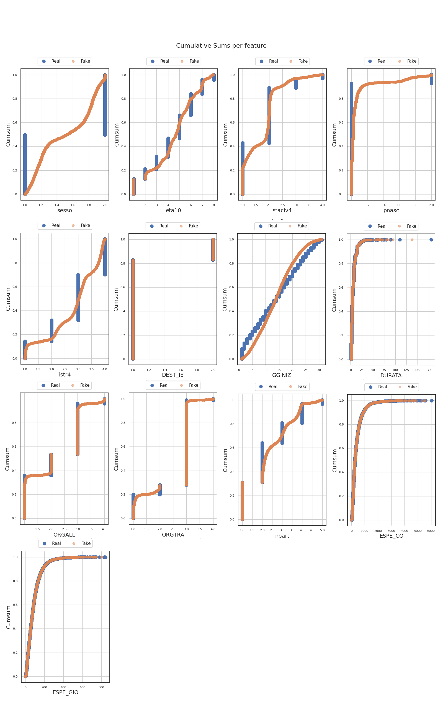
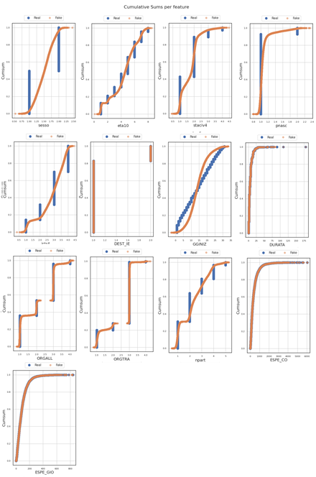
WP13’s Istat PoC – Cumulative Sums
With Table Evaluator we are able to determine the CumSums of each feature (variable) withing the c onsidered dataset.
A cumulative sum (often written as cumsum) is the running total of a sequence of numbers.
Running totals of values per column to detect systematic differences.
In other words, a cumulative sum (cumsum) is built from a distribution (a list of values) by adding each new value to the total of all previous ones.
Random Forest
XGBoost

Slide 18
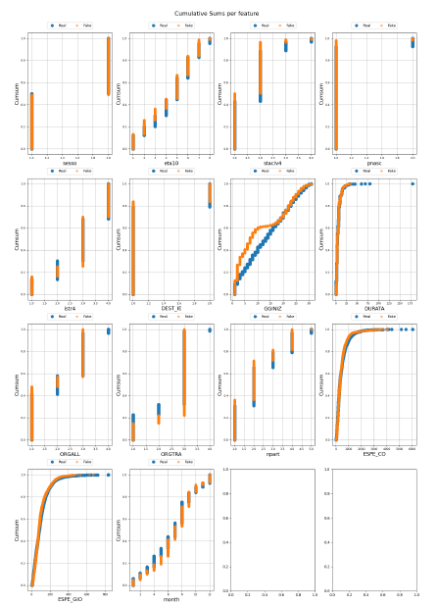
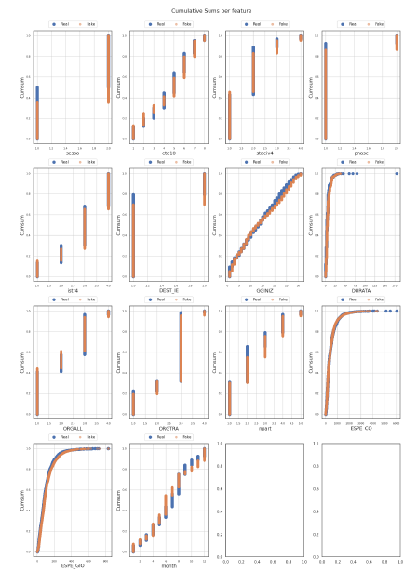
WP13’s Istat PoC – Cumulative Sums
Note: In the original distribution itself, the values are not sums of previous values. Only in the cumulative sum version do the values accumulate.
As we can see, it is evident from the cumulative distributions that the less effective methods, such as Random Forest or XGBoost, are less efficient on categorical variables, where they often fail to reproduce the categories, i.e. the domain values of these variables.
Variational Autoencoder (VAE)
CT-GAN

Slide 19
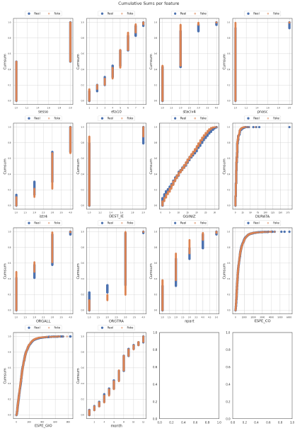
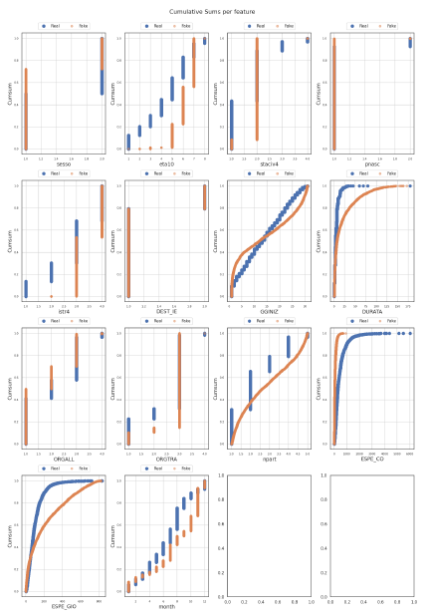
WP13’s Istat PoC – Cumulative SUMS
SMOTENC
DP-CTGAN
Moreover, even for continuous variables, these methods often show non-overlapping distributions. In the more effective methods, there is an almost perfect overlap between the real and synthetic cumulative distributions.
Therefore, the distribution-based approach immediately and visually highlights whether the reproduction of real data in the synthetic data is qualitatively perfect or not.

Slide 20
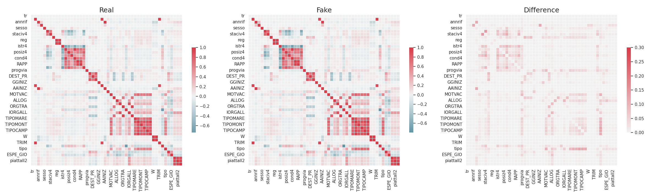
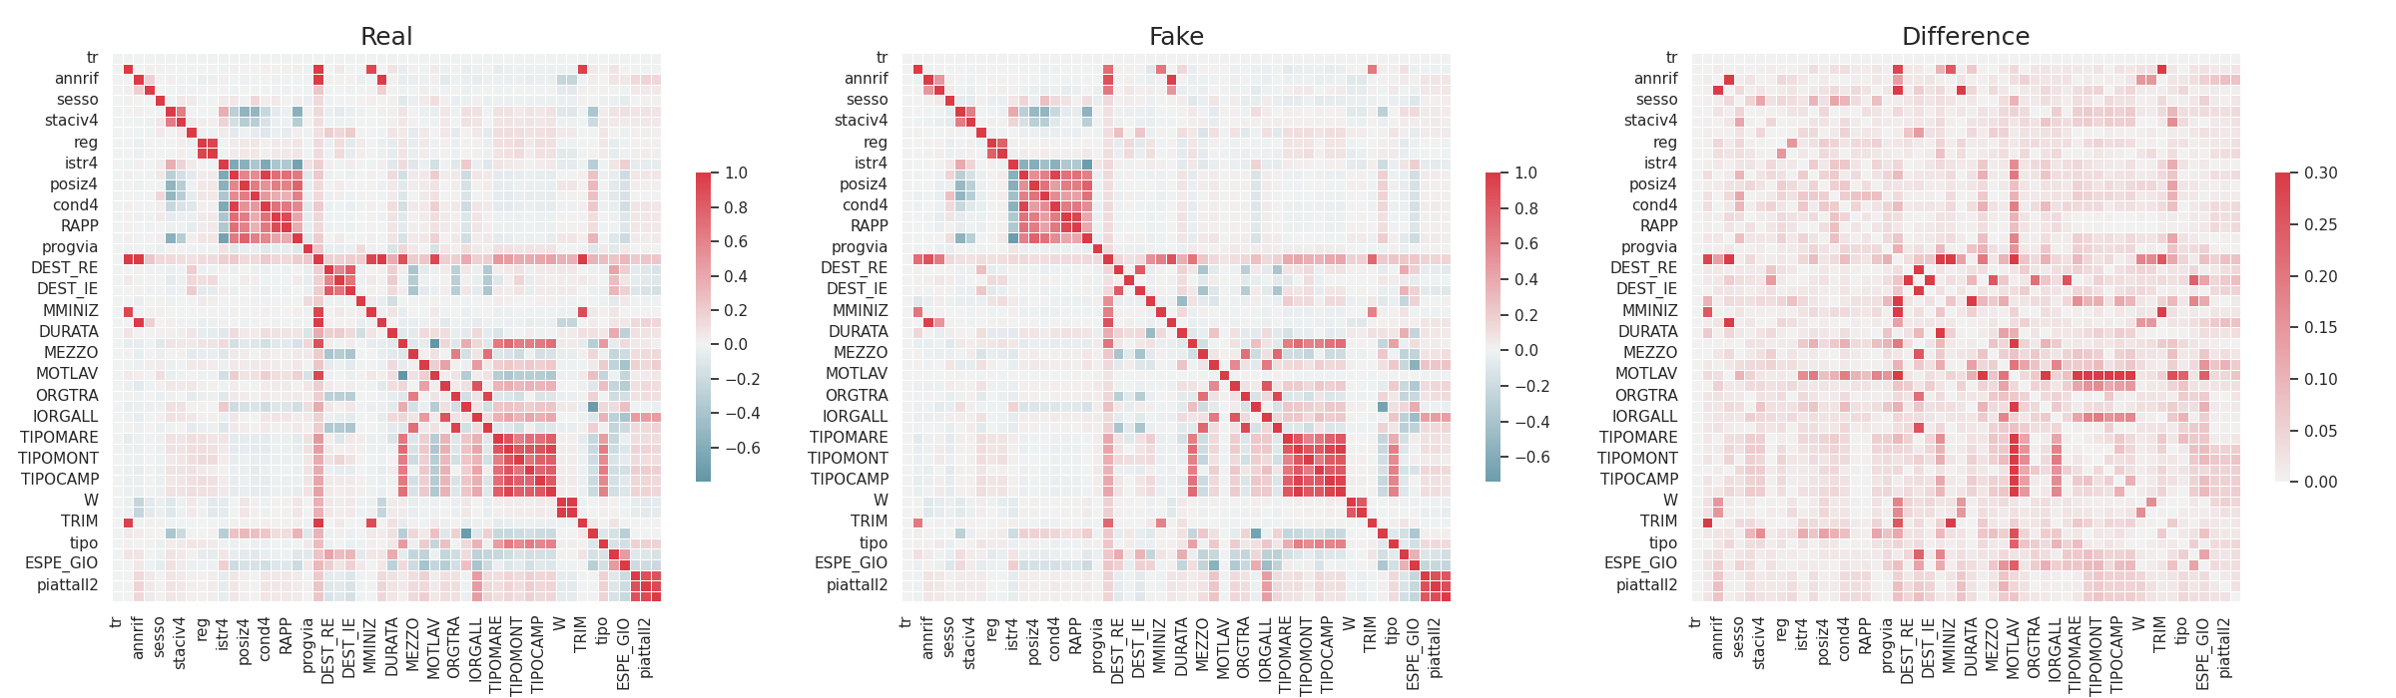
WP13’s Istat PoC – Correlations Heatmaps
Random Forest
A Correlation Heatmap is another visual tool that shows differences in variable correlations.
We calculate the correlation matrices of the original and synthetic data, then compute their differences. Larger differences indicate lower accuracy of the synthetic data generation method.
XGBoost

Slide 21
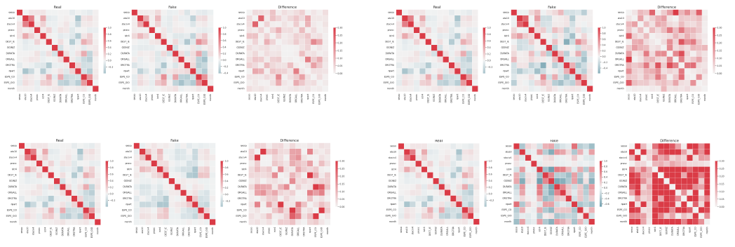
WP13’s Istat PoC – Correlations Heatmaps
SMOTENC
Variational Autoencoder (VAE)
CT-GAN
DP-CTGAN

Slide 22

WP13’s Istat PoC – Machine Learning Test
In the Machine Learning test, we measure performance (accuracy, F1-score, and recall) on the test set (20%) of a Random Forest classifier. The classifier is trained twice: once using the original dataset and once using the synthetic dataset as training set, considering the variable "motvac" as the target.
The same classifier is applied to all methods. According to theory, if the synthetic data generator correctly captures the statistical properties of the original dataset within the synthetic dataset, then the machine learning performance on the synthetic dataset should naturally approach the performance on the original dataset. Otherwise, the data synthesis is failing.

Slide 23
WP13’s Istat PoC – Machine Learning Test
As we can observe, apart from SMOTENC which tends to reproduce the data exactly, the best methods seem to be the deep learning–based ones such as CTGAN and VAE, as they achieve high accuracy but not identical to the original dataset, as expected. In fact, during the synthetic data generation process something is always lost in terms of the properties of the data being reproduced.
Model | Accuracy | F1-Score | Recall
Original Data | 0.964516848 | 0.964516848 | 0.964516848
RF | 0.660685592 | 0.660685592 | 0.660685592
XGB | 4.46349e-05 | 4.46349e-05 | 4.46349e-05
SMOTENC | 0.992813783 | 0.992813783 | 0.992813783
DPCTGAN | 4.46349e-05 | 4.46349e-05 | 4.46349e-05
VAE | 0.892385288 | 0.892385288 | 0.892385288
CTGAN | 0.896134619 | 0.896134619 | 0.896134619

Slide 24
WP13’s Istat PoC – Conclusions and Next Steps
Conclusions
The tested methods (RF, XGB, VAE, CTGAN, DP-CTGAN) show different performance levels: advanced generative models (VAE, CTGAN) better reproduce data distributions compared to simpler approaches.
The introduction of Differential Privacy reduces fidelity to real data but provides stronger privacy guarantees.
The project is ongoing and not yet completed: current results should be seen as preliminary indications.
Synthetic data appear to be a promising solution to privacy and data access challenges, but further validation is needed to balance statistical quality and data protection.
Next Steps
Implementation of privacy risk measures
Assessment of the utility / privacy risk trade-off.

Slide 25
References
Goodfellow, I., Pouget-Abadie, J., Mirza, M., Xu, B., Warde-Farley, D., Ozair, S., ... & Bengio, Y. (2014). Generative adversarial nets. Advances in neural information processing systems, 27.
Xu, Lei, et al. "Modeling tabular data using conditional gan." Advances in neural information processing systems 32 (2019).
Wu, J.; Plataniotis, K.; Liu, L.; Amjadian, E.; Lawryshyn, Y. Interpretation for Variational Autoencoder Used to Generate Financial Synthetic Tabular Data. Algorithms 2023, 16, 121. https://doi.org/10.3390/a16020121
Synthetic Data Vault: https://docs.sdv.dev/sdv
McHugh, Mary L. "The chi-square test of independence." Biochemia medica 23.2 (2013): 143-149.

Slide 26
Thanks
FRANCESCO PUGLIESE | francesco.pugliese@istat.it
ANGELA PAPPAGALLO | angela.pappagallo@istat.it
MASSIMO DE CUBELLIS | massimo.decubellis@istat.it

